Slide 1
Linear algebra:
Least Square
主讲人：常万里

Slide 2

Reference
MIT 18.06 Linear Algebra
https://ocw.mit.edu/courses/mathematics/18-06-linear-algebra-spring-2010/
http://open.163.com/special/opencourse/daishu.html

Slide 3
Index
Projections review
Least squares
The matrix A^{T}A

Slide 4
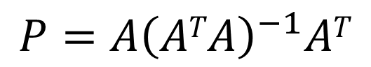
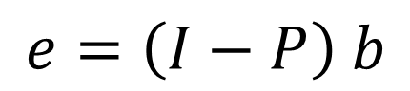
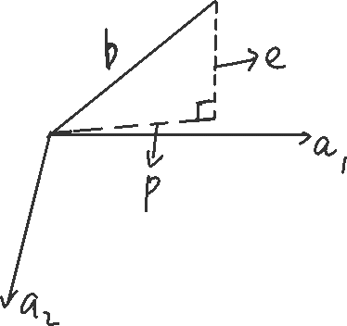
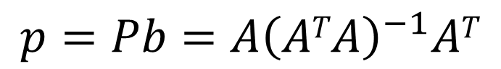
Projections review
Projection matrix:
$${P=A\left(ATA\right)}^{−1}AT$$
$$p=Pb={A\left(ATA\right)}^{−1}AT$$
$$e=\left(I−P\right) b$$

Slide 5
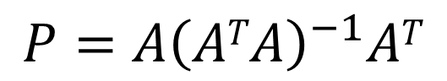
$${P=A\left(ATA\right)}^{−1}AT$$
If b in column space of A , Pb = b
If b in N(A^{T}), i.e. b⊥A, Pb = 0
Notes:
If b in column space of A ，$AT$X=b
If b in N(A^{T}), $AT$b=0
画几何表示A 和 N(A^{T}),

Slide 6
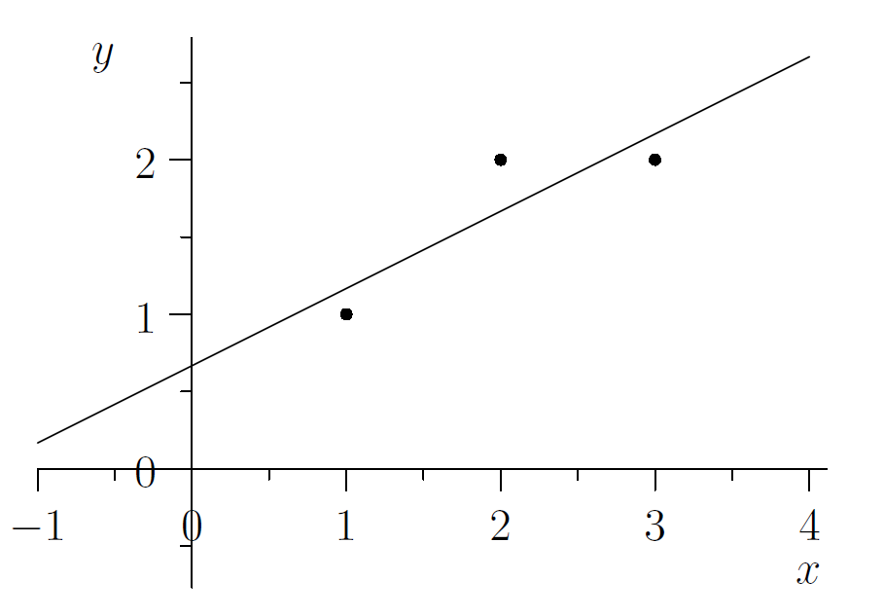
Least squares
We want to find the closest line b = C + Dt to the points (1, 1), (2, 2), and (3, 2).
Which mean “closest” ?
Notes:
By “closest” line we mean one that minimizes the error represented by the distance from the points to the line.
We measure that error by adding up the squares of these distances. In other words, we want to minimize ||Ax ⁻ b|| ² =||e||²

Slide 7
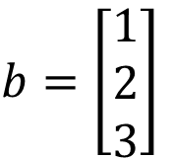
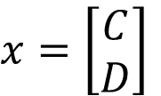
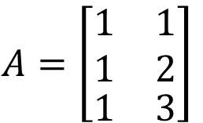
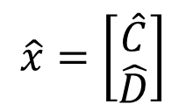
C + D = 1
C + 2D = 2
C + 3D = 2
$$b=\left[\begin{matrix}1 \\ 2 \\ 3\end{matrix}\right]$$
$$A=\left[\begin{aligned}\begin{matrix}1 & 1 \\ 1 & 2\end{matrix} \\ \begin{matrix}1 & 3\end{matrix}\end{aligned}\right]$$
$$x=\left[\begin{matrix}C \\ D\end{matrix}\right]$$
$$\hat{x}=\left[\begin{matrix}\hat{C} \\ \hat{D}\end{matrix}\right]$$
Notes:
A^{T}(b ⁻ Axˆ ) = 0
A^{T}b =A^{T} Axˆ
3C^{ˆ}+ 6D^{ˆ}= 56
C^{ˆ}+ 14D^{ˆ}= 11.
D^{ˆ}= 1/2 and C^{ˆ}= 2/3.
Minimize e²¹ + e²² + e³² =(C + D ⁻ 1)² +(C + 2D ⁻ 2)² +(C + 3D ⁻ 2)².

Slide 8
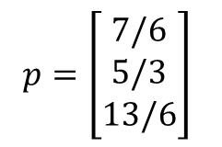
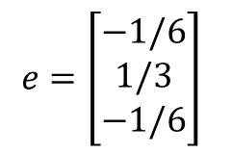
i | p_{i} | b_{i} | e_{i}
1 | 7/6 | 1 | -1/6
2 | 5/3 | 2 | 1/3
3 | 13/6 | 3 | -1/6
$$p=\left[\begin{matrix}7/6 \\ 5/3 \\ 13/6\end{matrix}\right]$$
$$e=\left[\begin{matrix}−1/6 \\ 1/3 \\ −1/6\end{matrix}\right]$$
Notes:
P 垂直于 e ？？
E垂直于整个A

Slide 9
The matrix A^{T}A
We’ve been assuming that the matrix A^{T}A in ${P=A\left(ATA\right)}^{−1}AT$is invertible. Is this justified?
Conclusion: If A has independent columns, then A^{T}A is invertible
Proof:
Notes:
Want A^{T}A is invertible ,
等价于 |A^{T}A| != 0,
等价于 A^{T}A has independent cols,
等价于 A^{T}Ax = 0, 唯一解x = 0: 列的组合
A^{T}Ax = 0
x^{T}A^{T}Ax = x^{T}0
(Ax)^{T}(Ax)= 0
Ax = 0.

